Slide 1
Unit VI For Live Session Assignment
By: Rajat Chandna

Slide 2
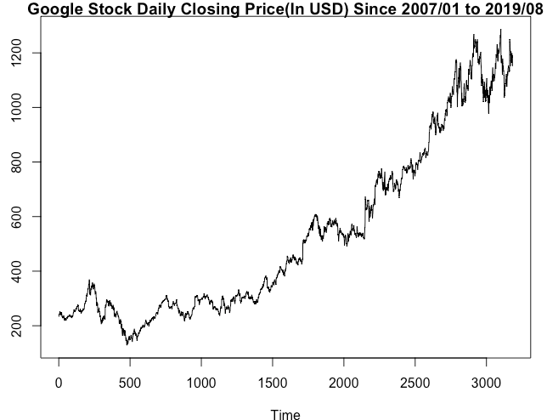
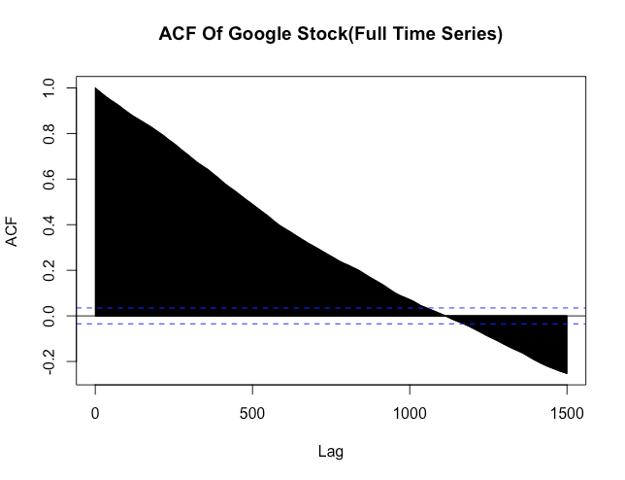
Looking at your time series from the first day of class, you addressed its stationarity before. Does either a signal plus noise, ARIMA, or ARUMA (seasonal) model seem appropriate?
Looking at realization and its correlation structure, which exhibits a very slowly damping structure with near value 1 correlation between large number of initial lags, it appears ARIMA model would be appropriate. Although it is counterintuitive to assume there might be a trend component in stock data, there is ever so slight possibility of trend component( liner or quadratic) in the realization in short term and hence signal plus noise model also appears to be appropriate. Now, since this stock is of Google, a tech company, with no particular product launch dates, it is counterintuitive to assume that its stock would be having some seasonal components. Moreover, autocorrelation plot doesn’t indicate any high correlation among monthly, quarterly, yearly etc lags ie no seasonal correlation structure. Hence, ARUMA(Seasonal) model might not be appropriate to model this stock data.

Slide 3
Copy and paste the factor table for a seasonal model with s = 7.
> factor.wge(phi = c(rep(0,6), 1))
Coefficients of Original polynomial:
0.0000 0.0000 0.0000 0.0000 0.0000 0.0000 1.0000
Factor Roots Abs Recip System Freq
1-1.0000B 1.0000 1.0000 0.0000
1+0.4450B+1.0000B^2 -0.2225+-0.9749i 1.0000 0.2857
1-1.2470B+1.0000B^2 0.6235+-0.7818i 1.0000 0.1429
1+1.8019B+1.0000B^2 -0.9010+-0.4339i 1.0000 0.4286

Slide 4
Pick a stock and download the last year's worth of daily stock price data.
Plot the data.
library(tswge)
library(quantmod)
start <- as.Date("2018-09-26")
end <- as.Date("2019-09-27")
getSymbols("AAPL", src = "yahoo", from = start, to = end)
plotts.wge(AAPL$AAPL.Close)
Take the first difference, and then estimate the structure of differenced data.
FirstDiff <- artrans.wge(AAPL$AAPL.Close, 1)
From this information, suggest a model for the data.
aic5.wge(FirstDiff)
---------WORKING... PLEASE WAIT...
Five Smallest Values of aic
p q aic
1 0 0 2.678261
2 0 1 2.683309
3 0 2 2.683813
4 1 0 2.683828
7 2 0 2.683963
As we can see that after taking the first difference, the correlation structure remained resembles that of white noise. Also transformed realization points to white noise structure with possible changing variance over time. Sample autocorrelations of original realization show a slowly damping structure, hinting towards ARIMA model. No seasonal component is evident in sample autocorrelation plot. Moreover, model fit on first order differenced data yields lowest AIC score for white noise ( p=0, q=0) among different models. Hence, ARIMA( 0, 1 , 0) model appears appropriate for this last year’s worth of Apple stock.

Slide 5
Key Takeaways and Questions

Slide 6
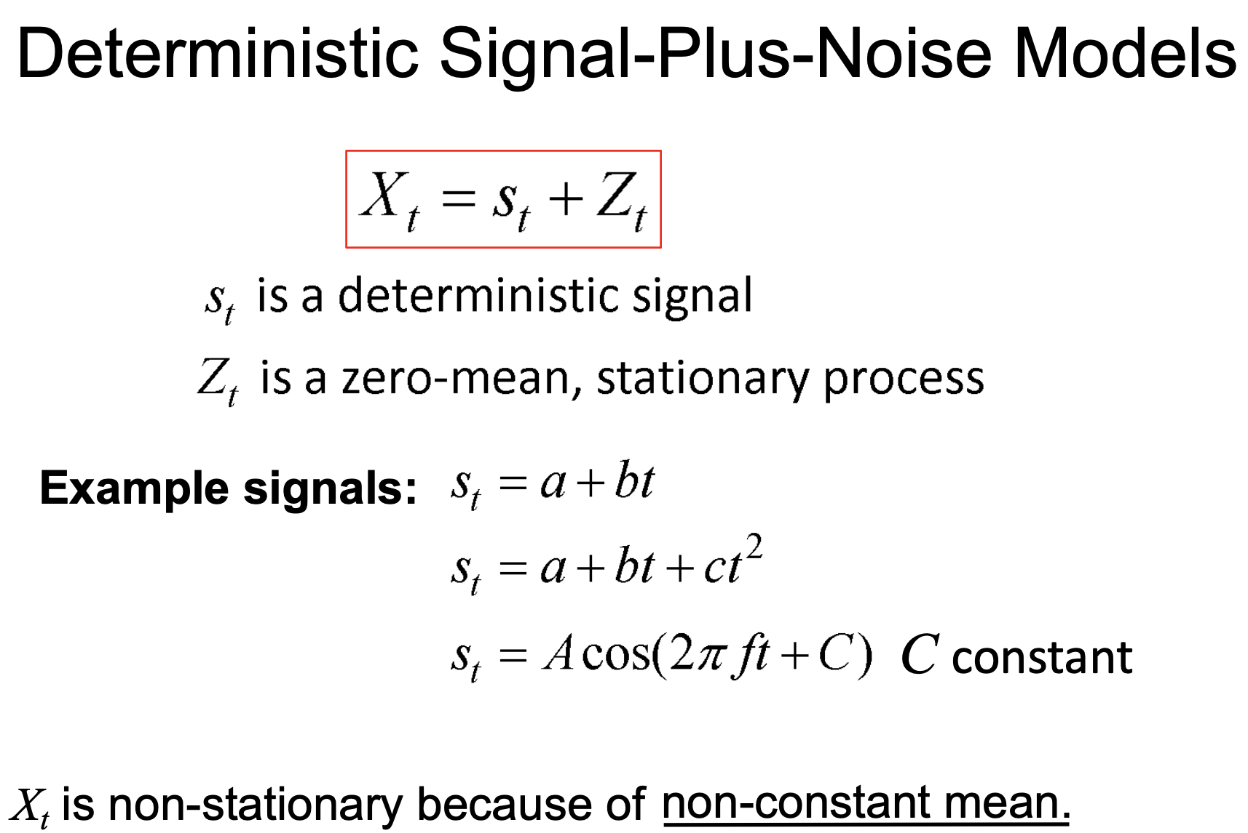
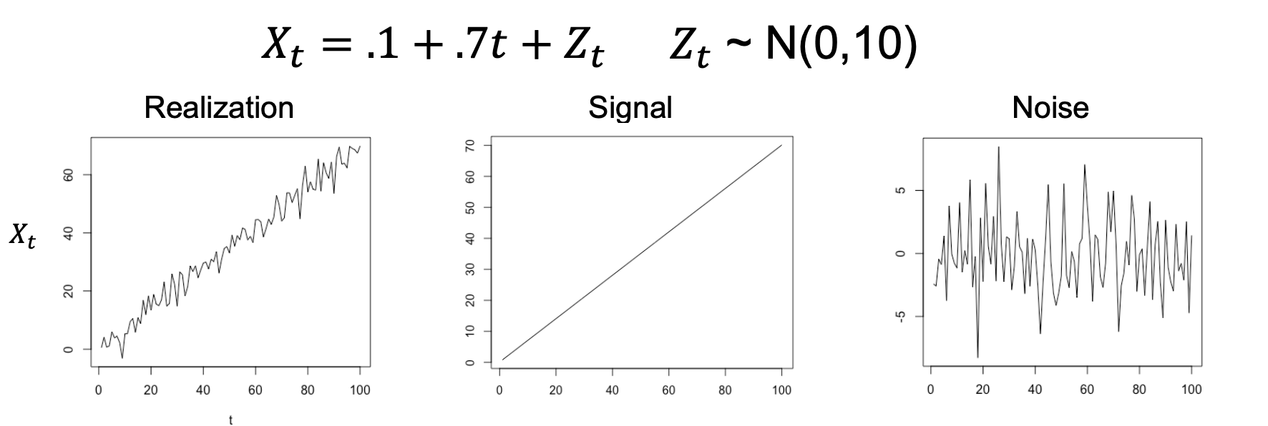
Key Takeaways
Zt could be any stationary process as AR, ARMA or simple uncorrelated white noise.
Mean is non-stationary as in above example:
Mean(t) = .1 + .7t
Since in real world, slope/intercept or any quadratic or harmonic trend etc of signal is not known, so first we estimate the signal fit and then model residuals with stationary Zt model as AR or ARMA. Etc, maybe using aic5.wge to find optimal model to fit residuals.

Slide 7
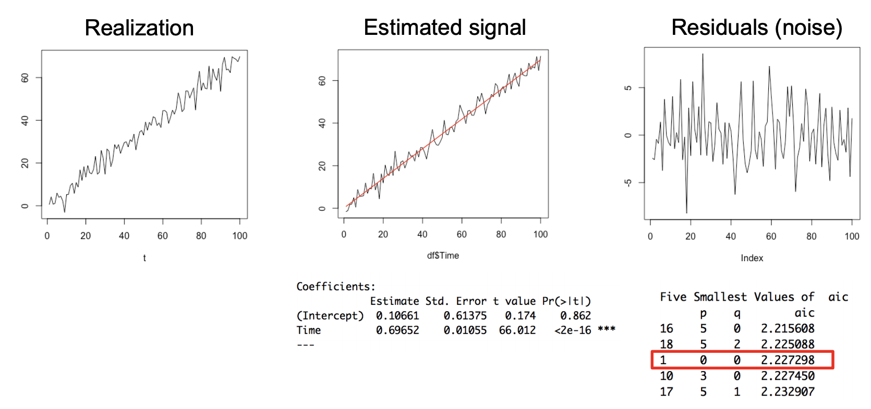
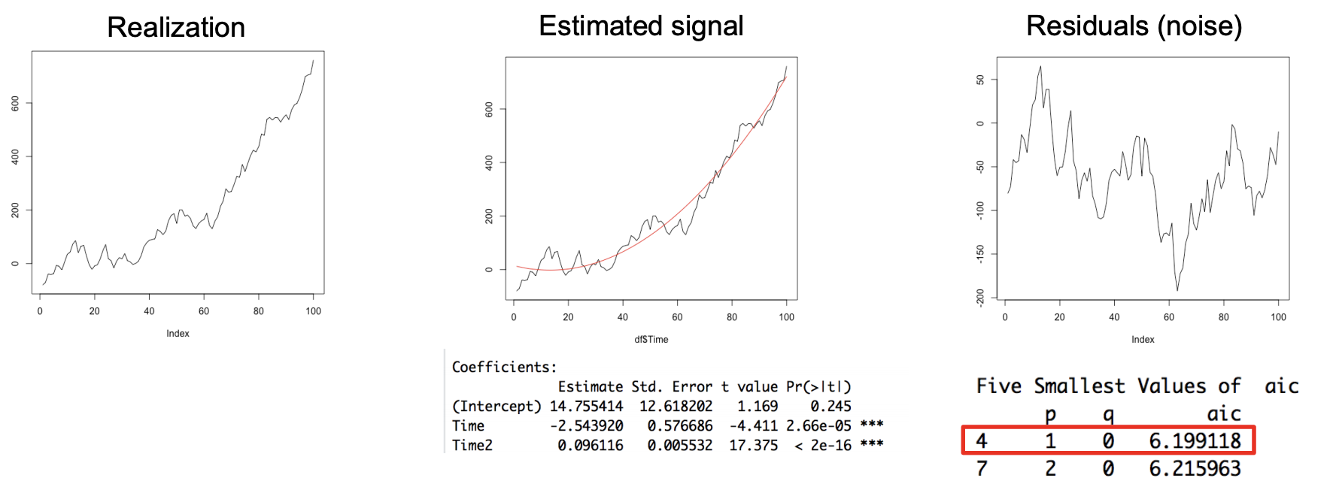
Key Takeaways
Some Examples of Deterministic signal plus noise models:

Slide 8
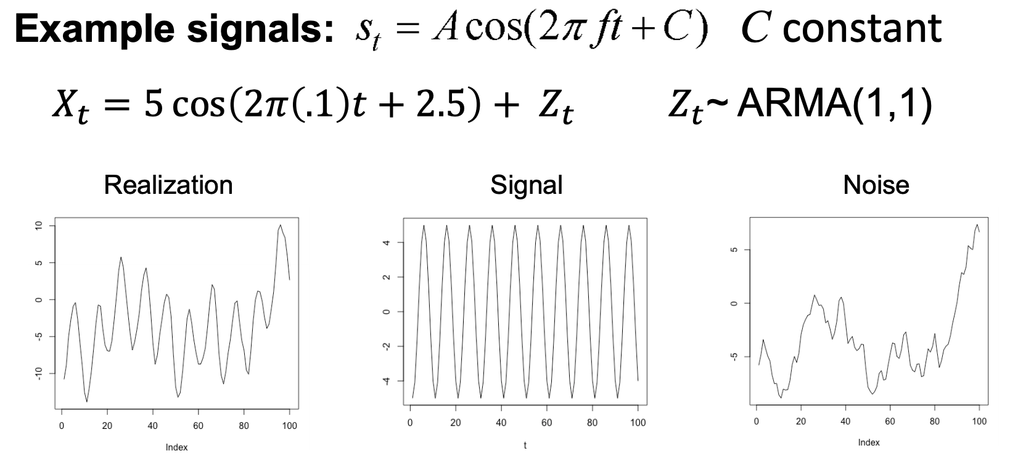
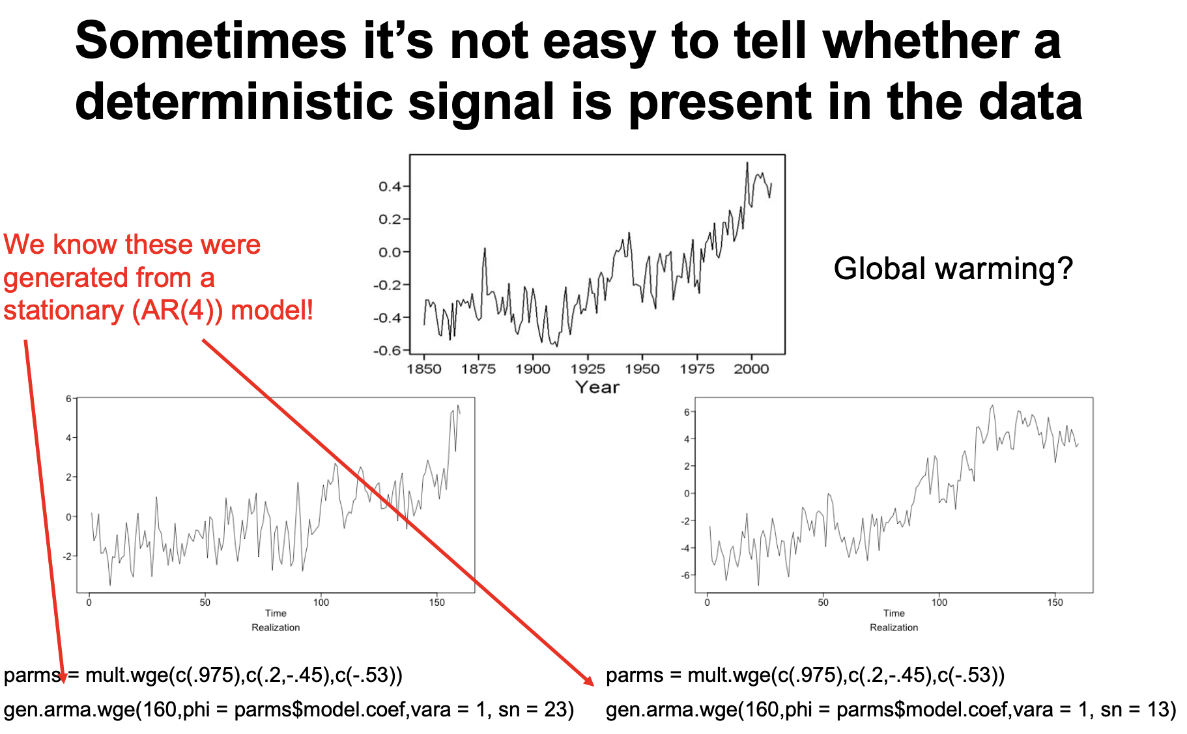
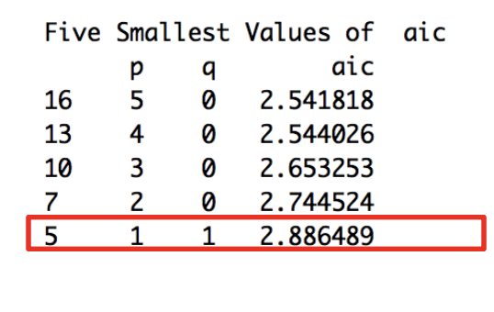
Key Takeaways
Some Examples of Deterministic signal plus noise models:
Sometimes it gets really difficult to tell whether real trend is present in data as in above example it might seem that there could be a liner or quadratic trend but such wandering can also be produced by AR(p) process with positive phi. Domain knowledge can help in this case.

Slide 9
Key Takeaways
Generate AR(p) model which are in factored form.
parms$model.coef
# Output: #
[1] 0.6450000 -0.0222500 0.0969000 0.2325375
parms = mult.wge(c(.975),c(.2,-.45),c(-.53)) gen.arma.wge(160,phi = parms$model.coef,vara = 1)

Slide 10
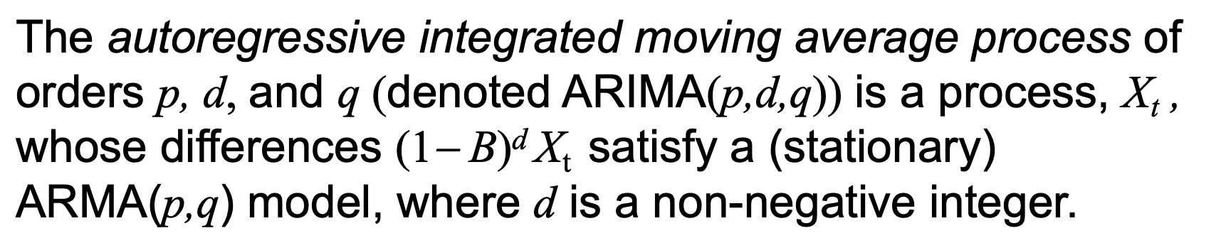
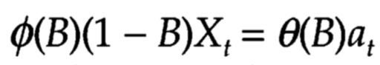
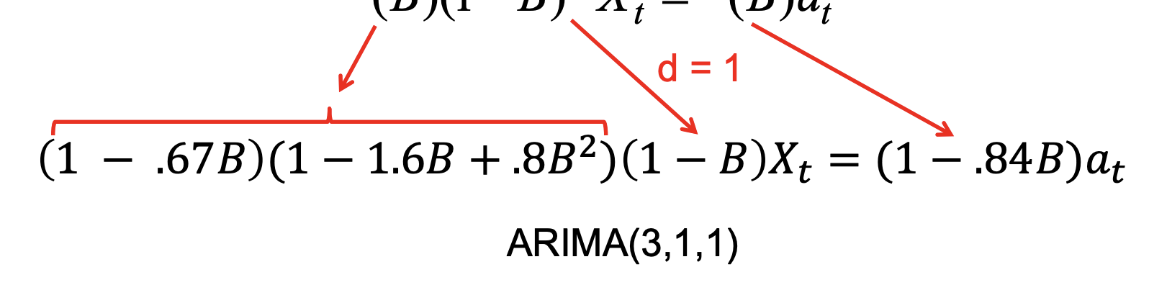
Key Takeaways
ARIMA Properties and Characteristics

Slide 11
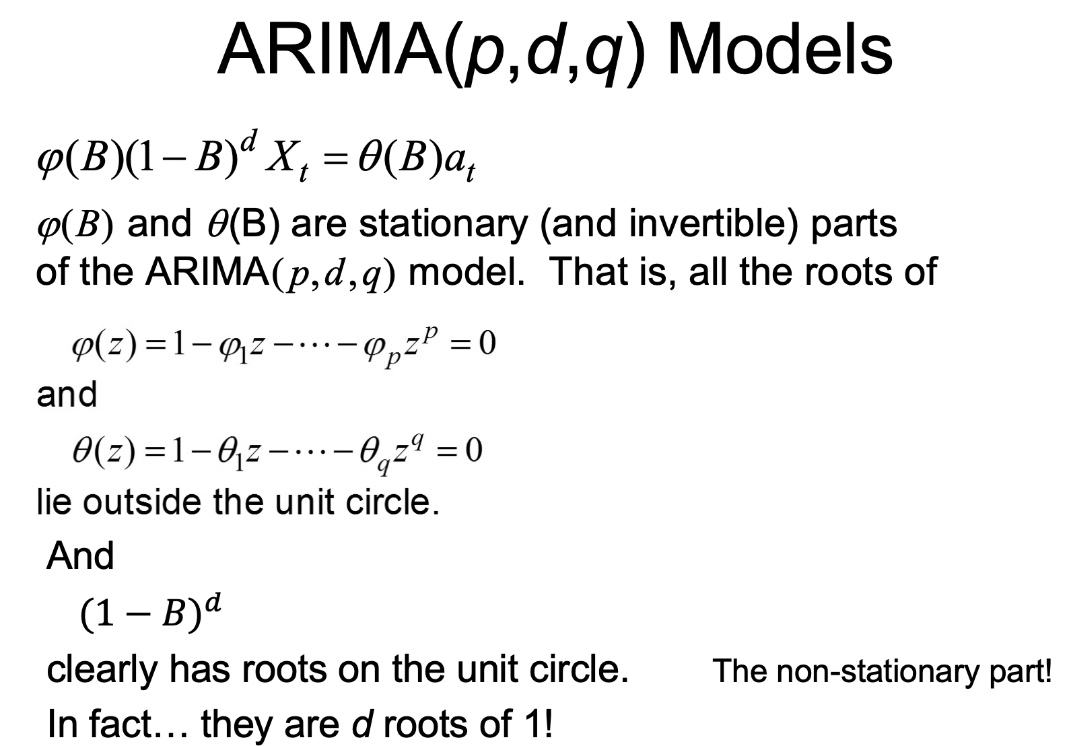
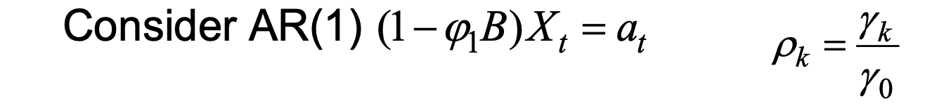
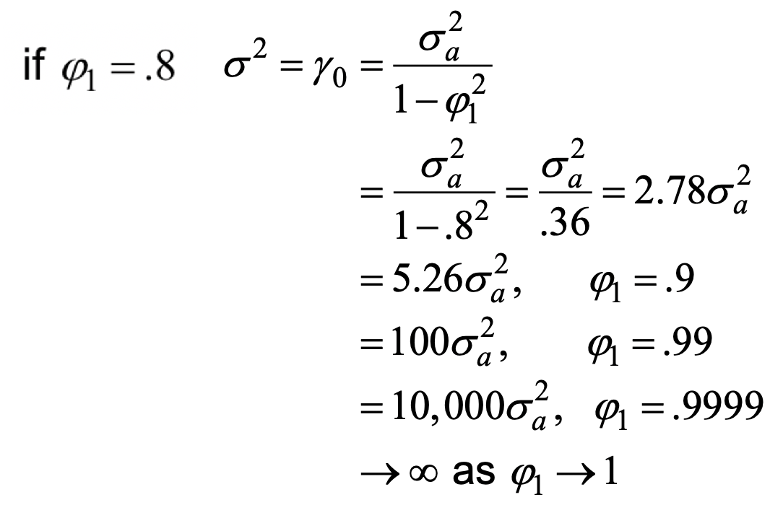
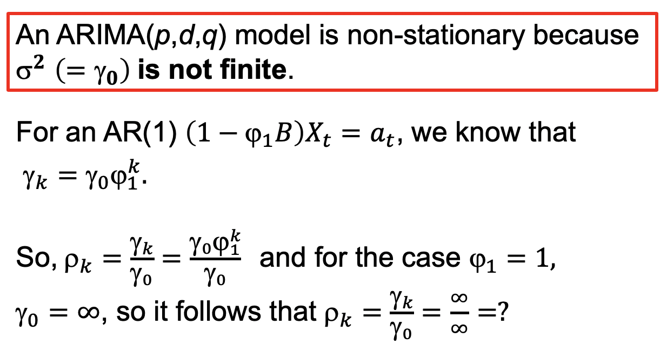
Key Takeaways
ARIMA Properties and Characteristics
What is ρ _{k} for an ARIMA(p,d,q) process?

Slide 12
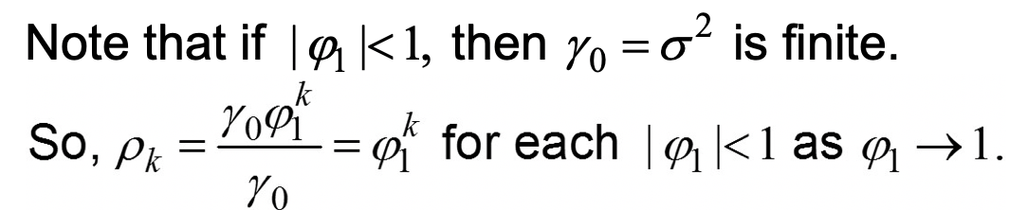
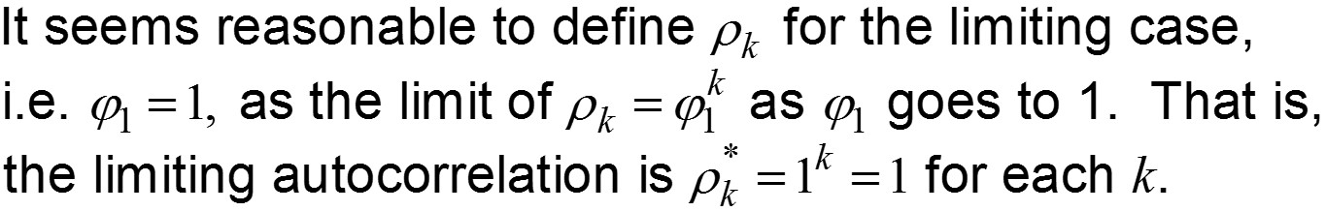
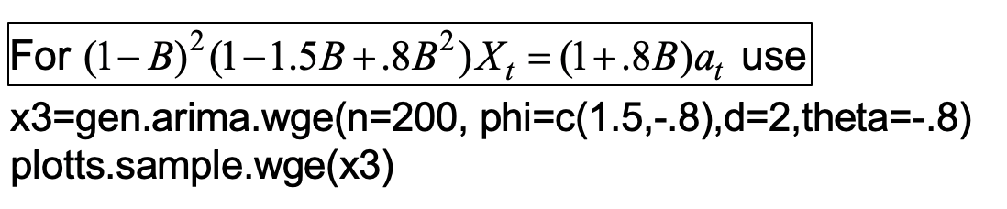
Key Takeaways
What is ρ _{k} for an ARIMA(p,d,q) process?
GENERATE ARIMA(2,2,1):

Slide 13
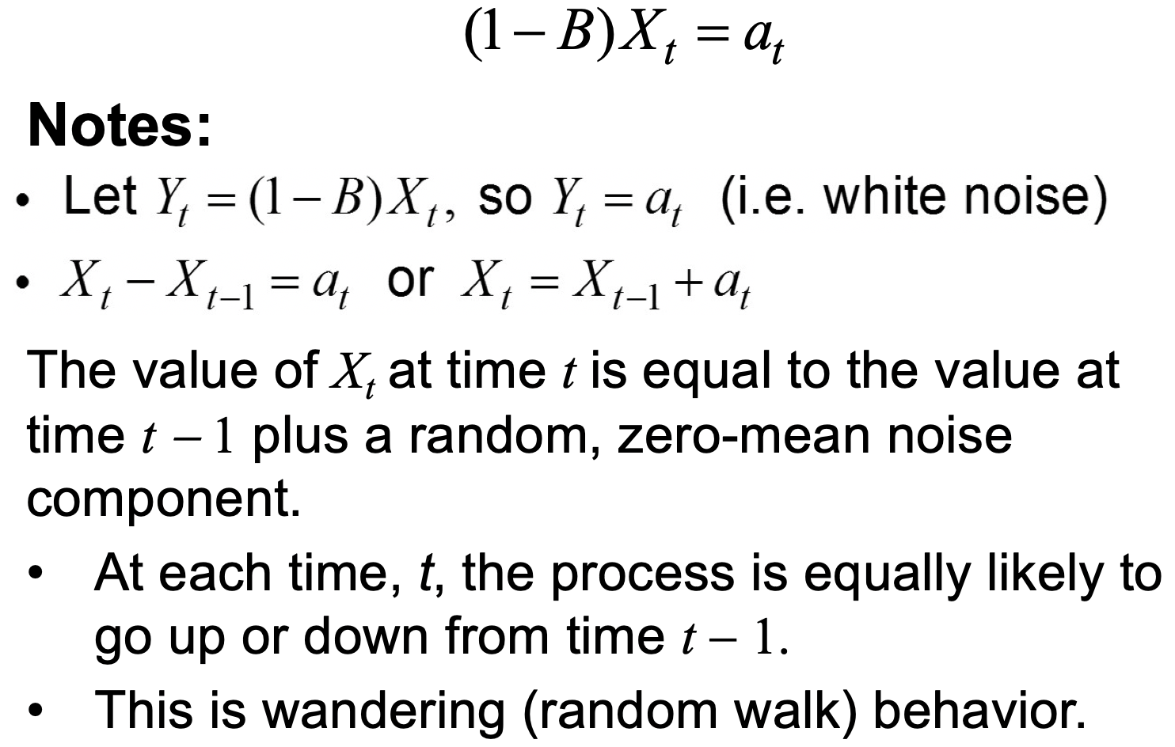
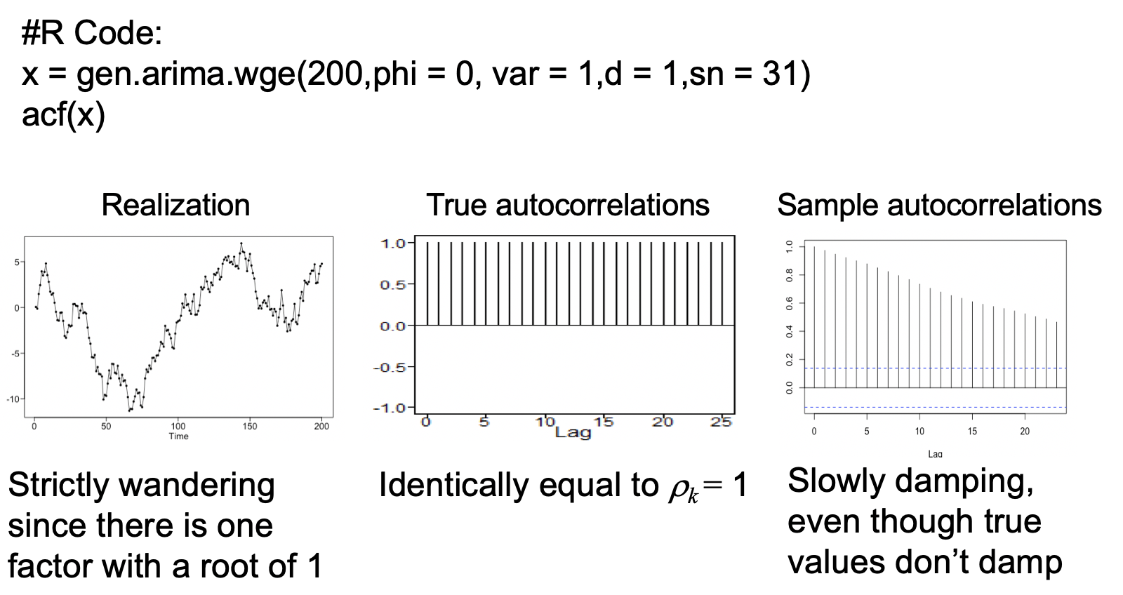
Key Takeaways
ARIMA(0,1,0)
EG: MOST STOCK DATA

Slide 14
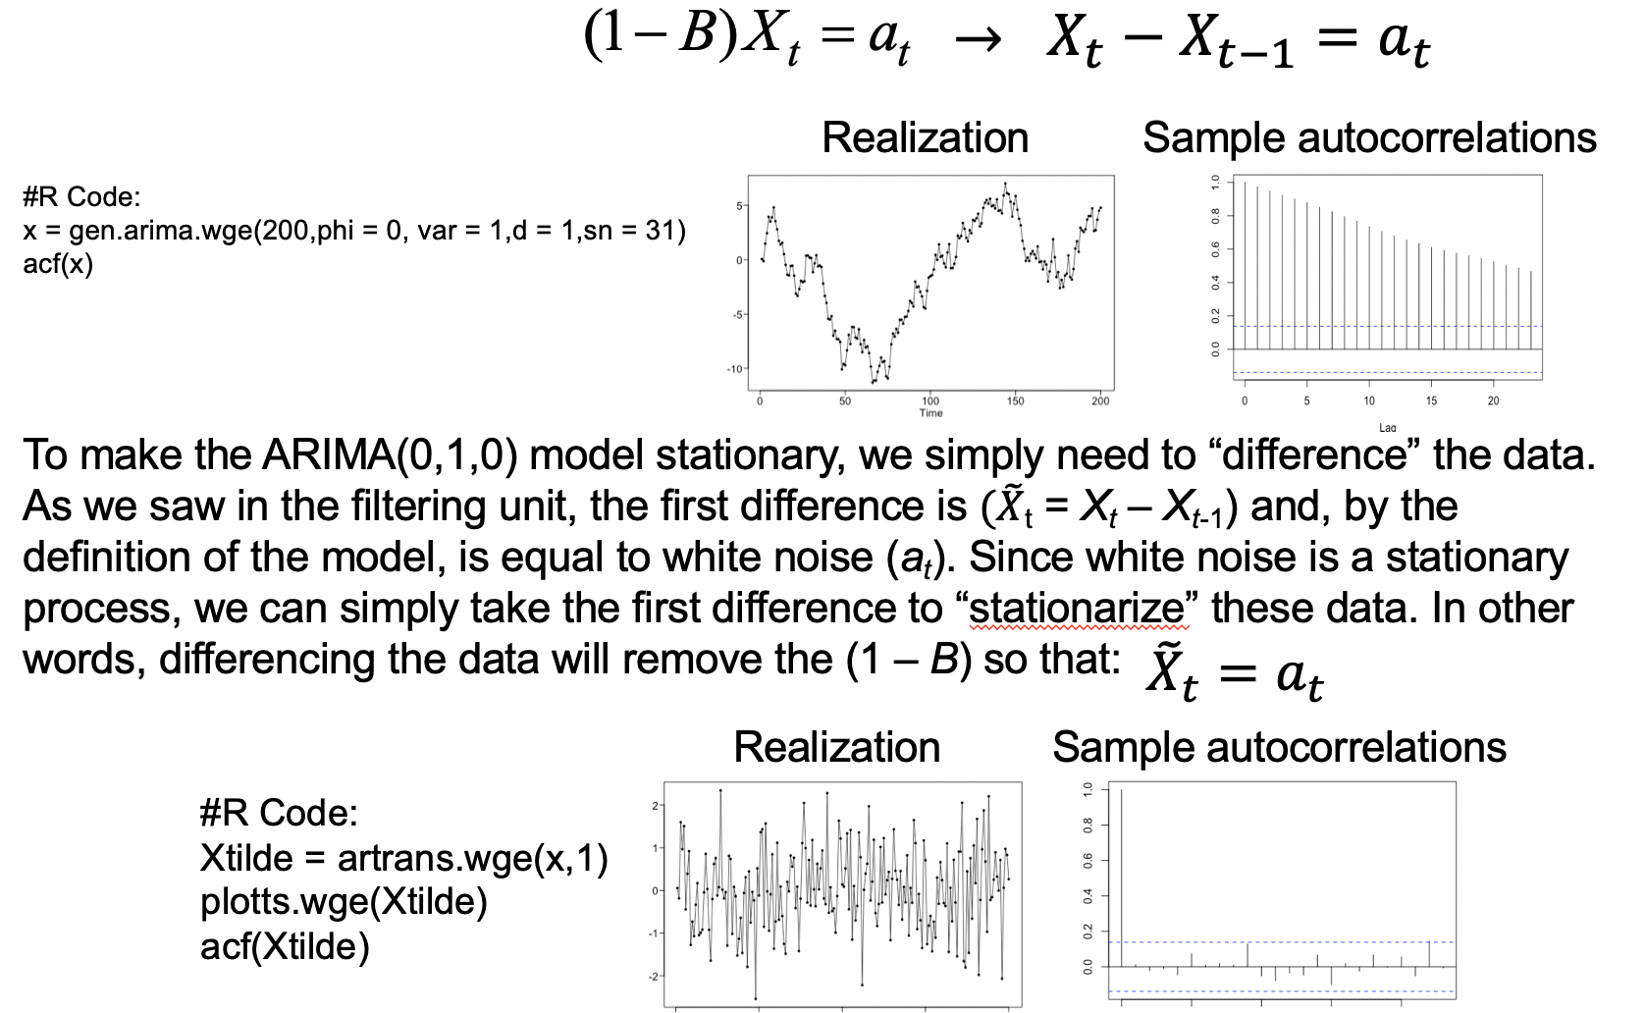
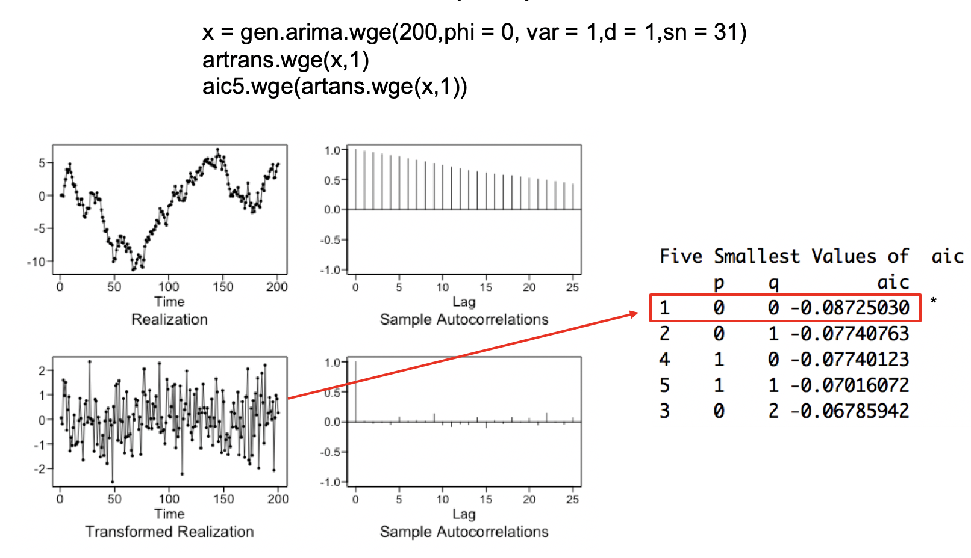
Key Takeaways
Stationarize the ARIMA(0,1,0): Taking out the (1 – B)

Slide 15
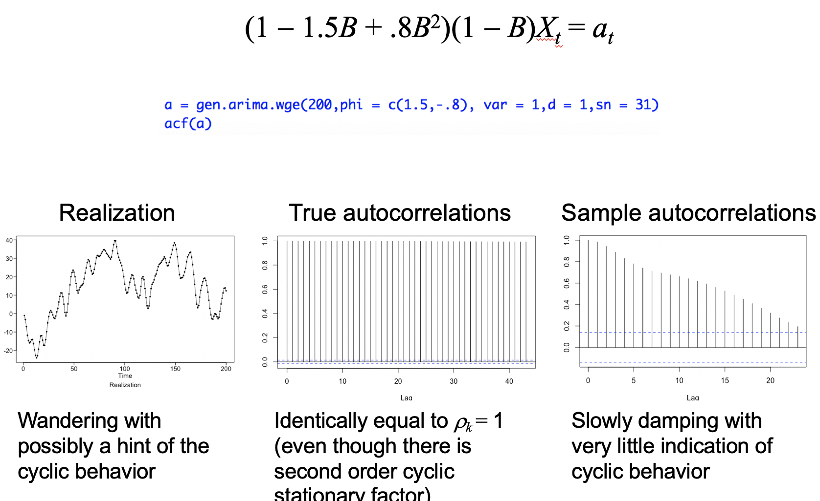
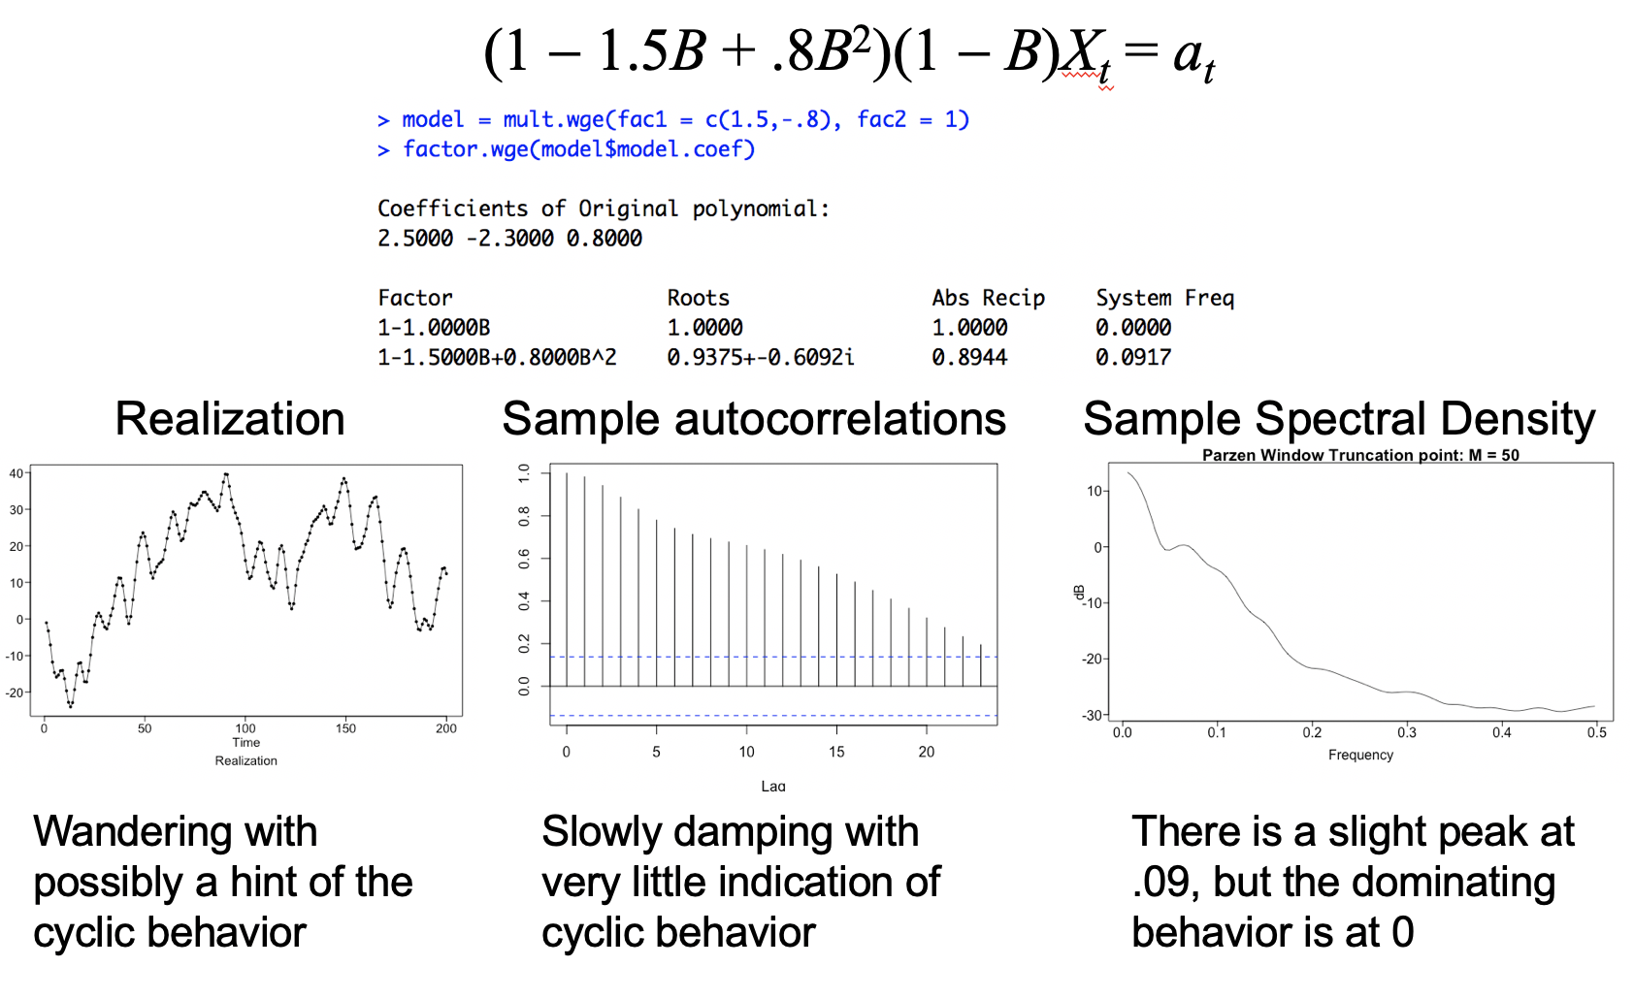
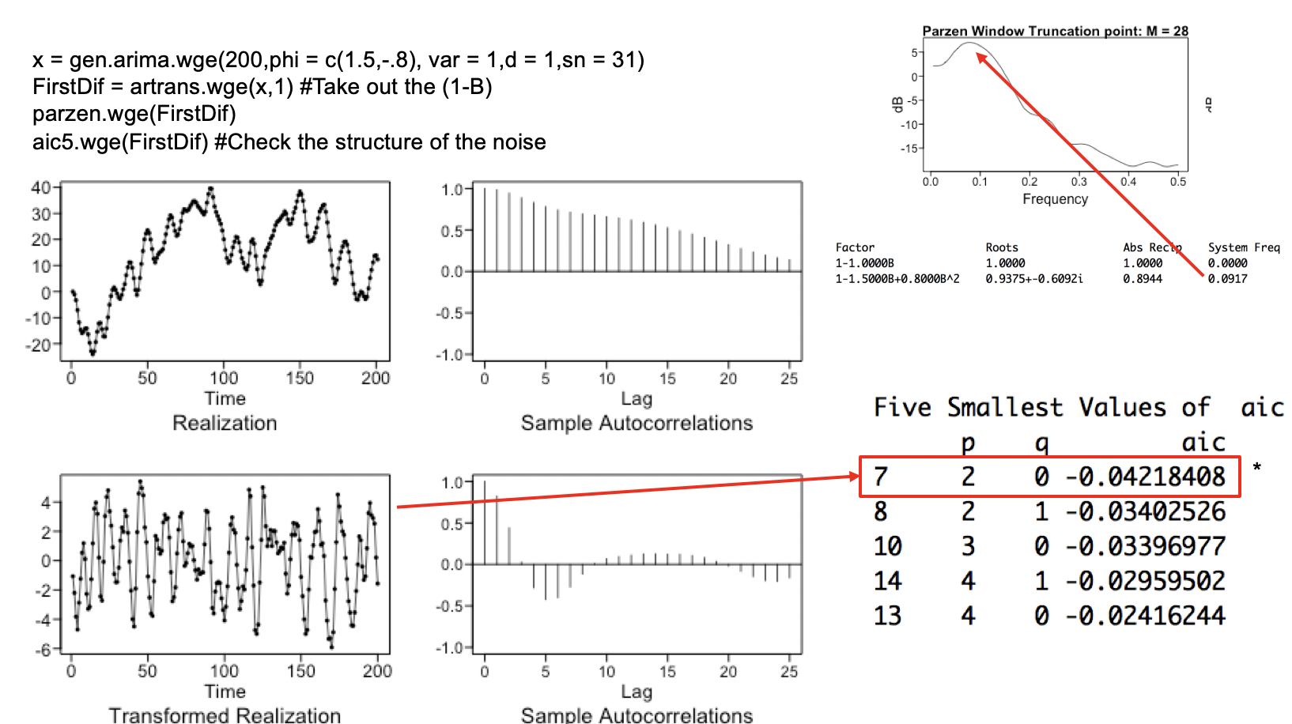
Key Takeaways
ARIMA(2,1,0) AND ITS STATIONARIZATION

Slide 16
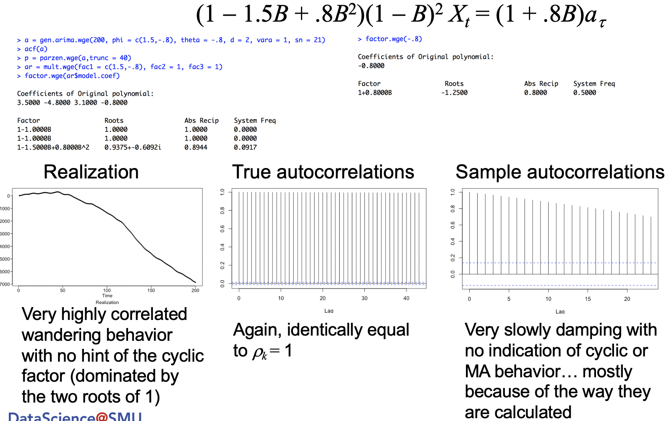
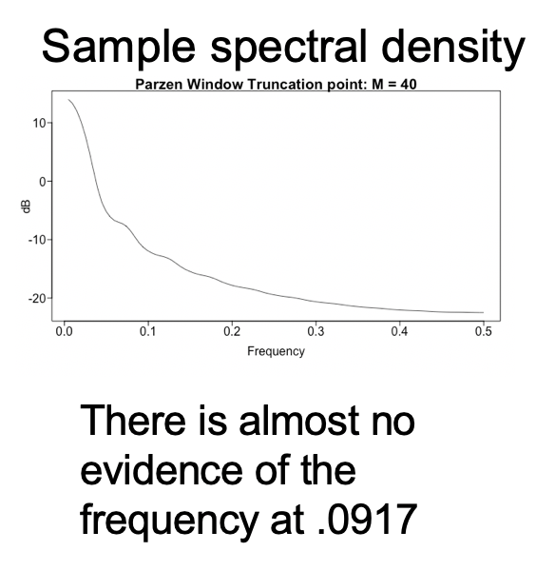
Key Takeaways
ARIMA(2,2,1)

Slide 17
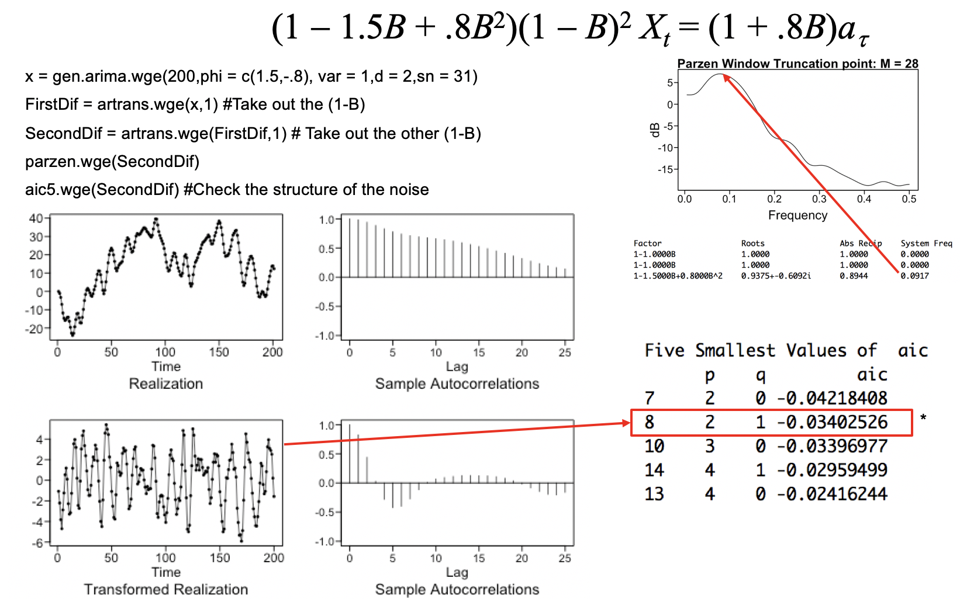
Key Takeaways
Stationarize the ARIMA(2,2,1): Taking out the (1 – B)²

Slide 18
Key Takeaways
General Comments about ARIMA Models
The (1 − B)^{d} factor dominates the stationary components.
In the realizations
Autocorrelations
Spectral densities all have peaks at f = 0
For d > 1, this domination is even more striking.
The true autocorrelations are equal to 1 for all k.
The sample autocorrelations will always damp (in part because of the way they are calculated).
Slowly damping sample autocorrelations is an indication of ARIMA data.

Slide 19
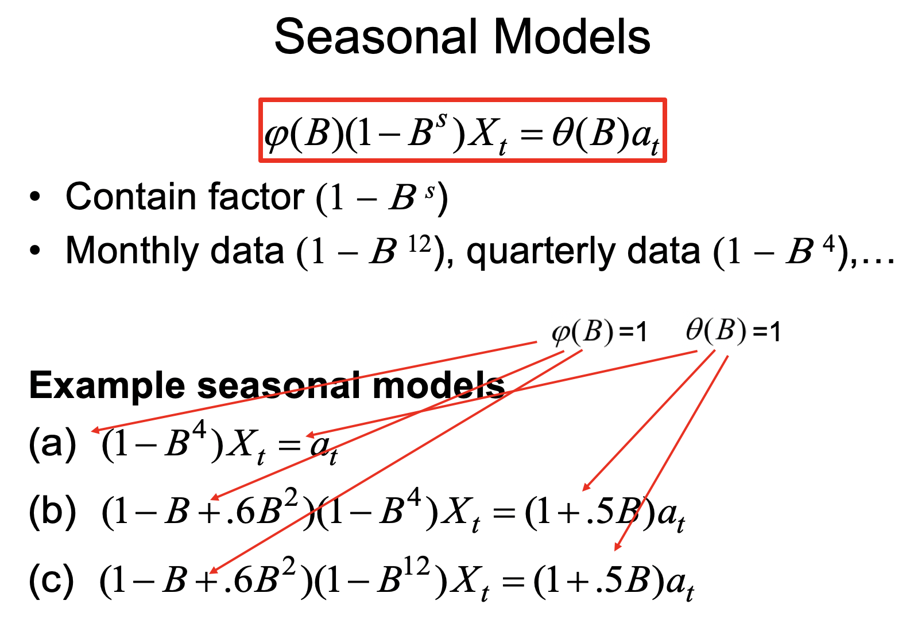
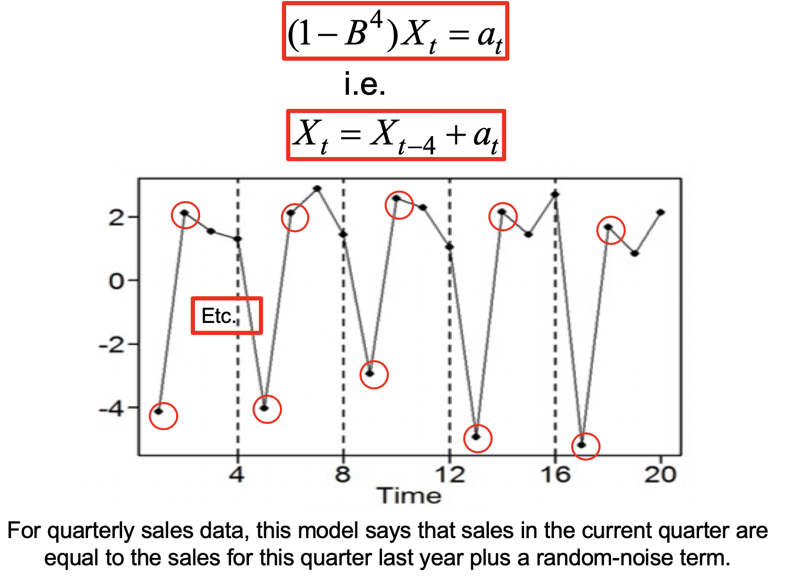
Key Takeaways
Seasonal Models | Properties and Characteristics

Slide 20
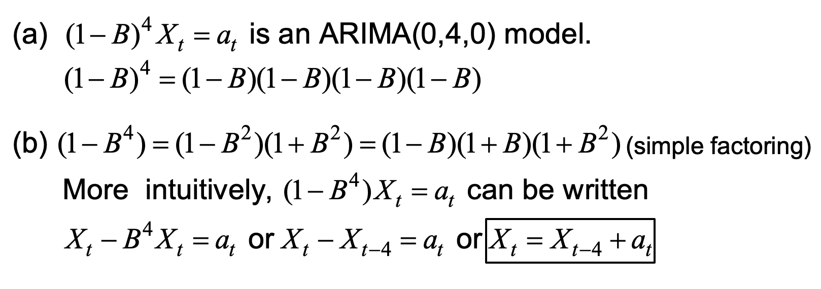
Key Takeaways

Slide 21
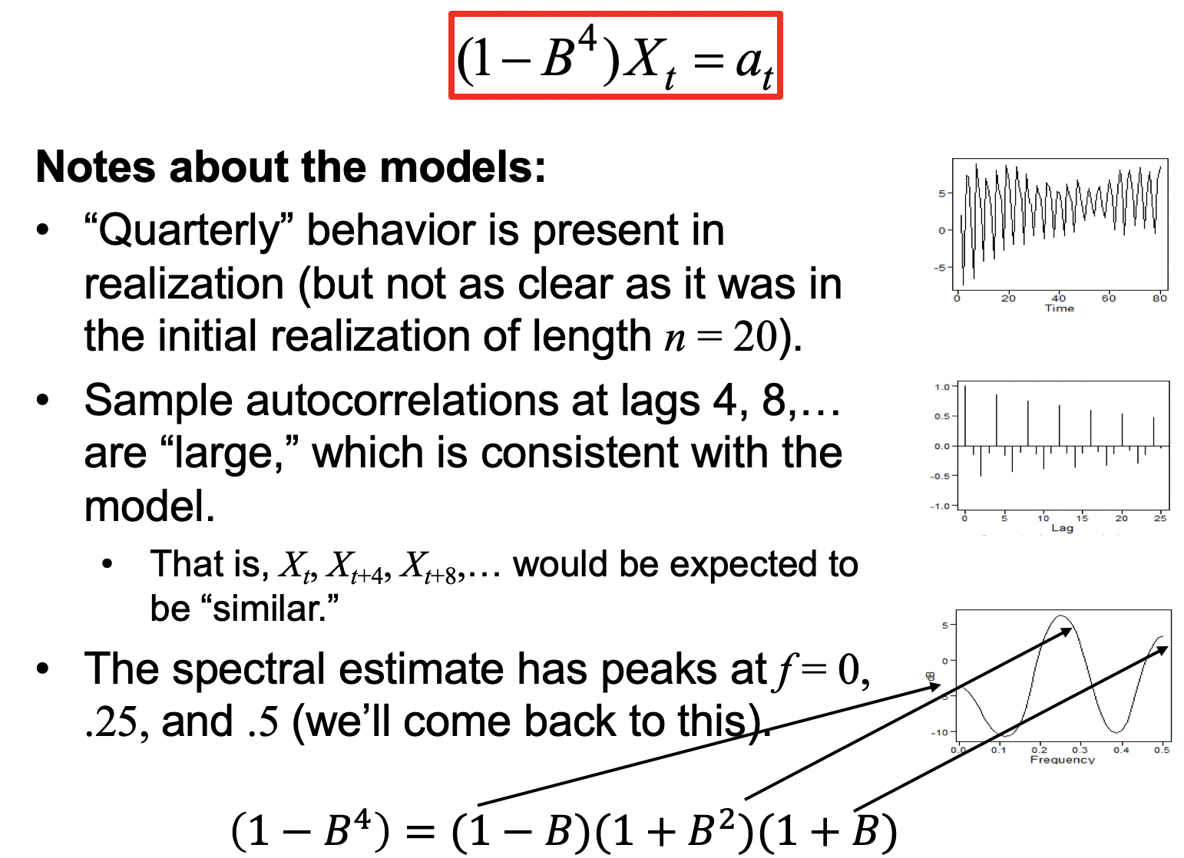
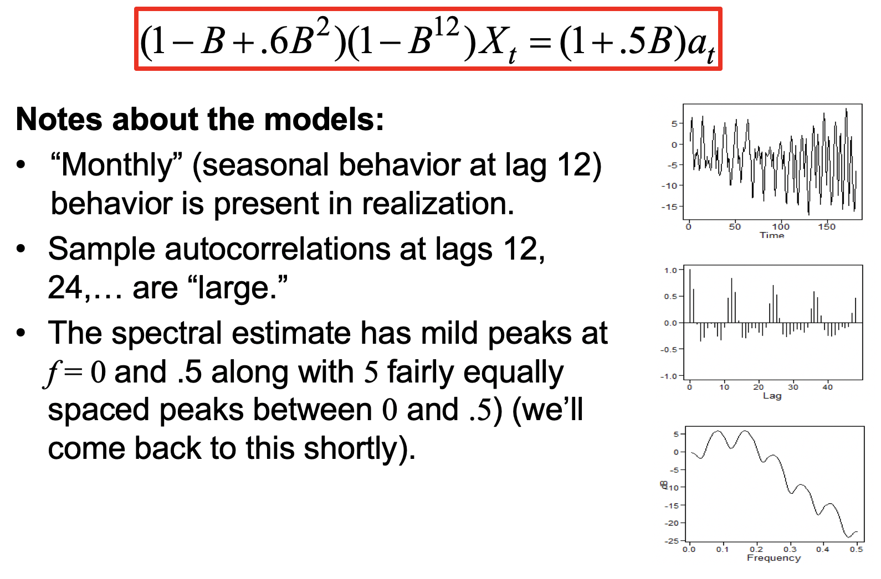
Key Takeaways
Seasonal Models | Examples

Slide 22
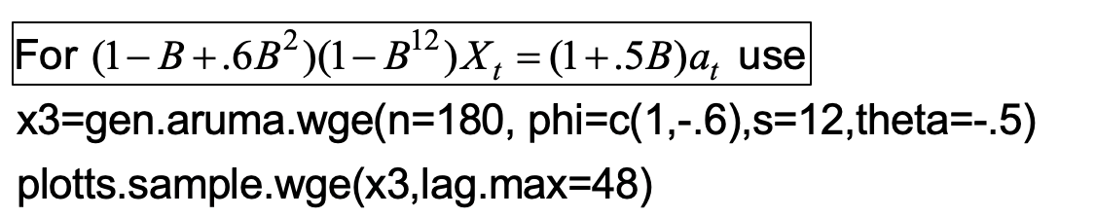
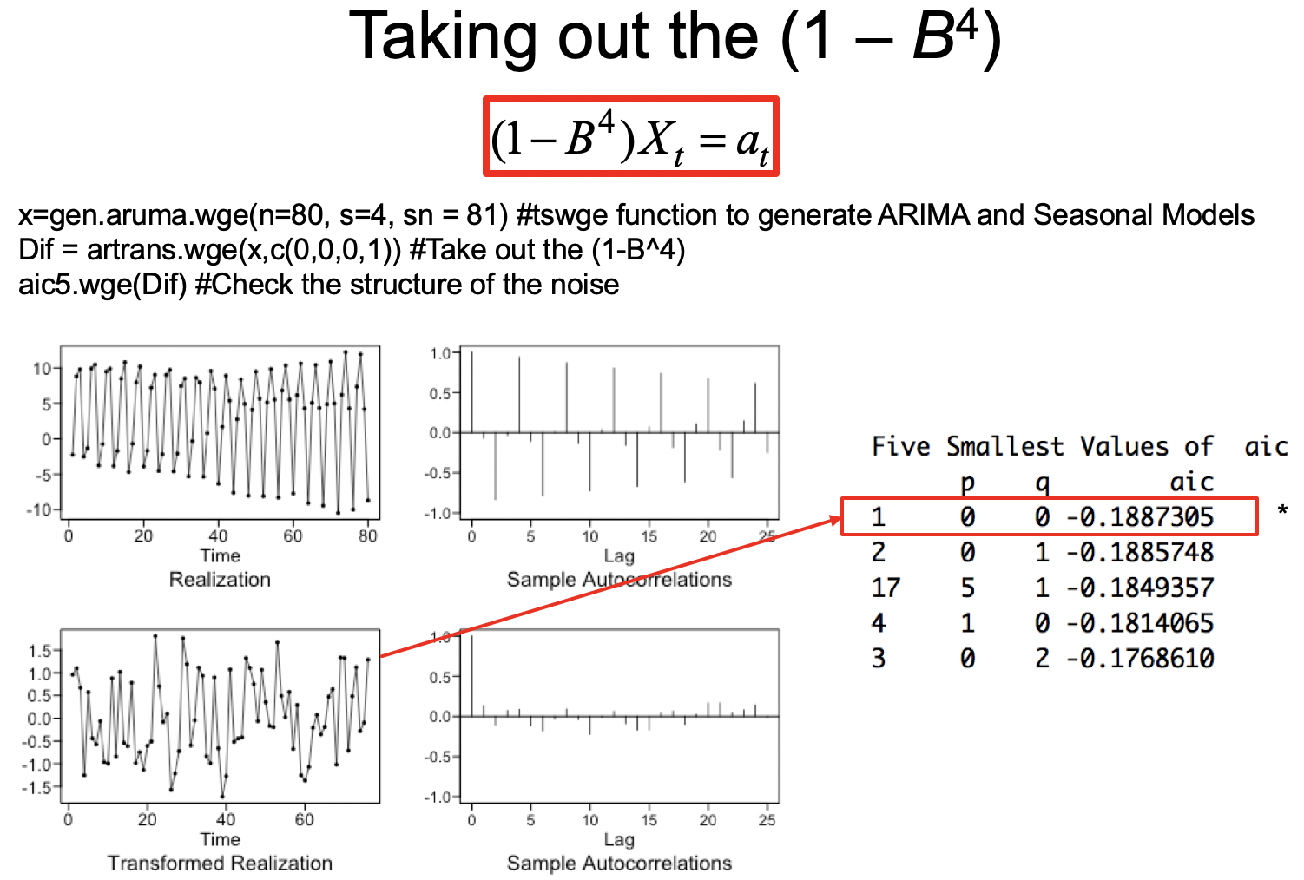
Key Takeaways
Seasonal Models | Generate And Stationarize
Quarterly Seasonal Model: 0 for B, 0 for B^2, 0 for B^3 and 1 for B^4

Slide 23
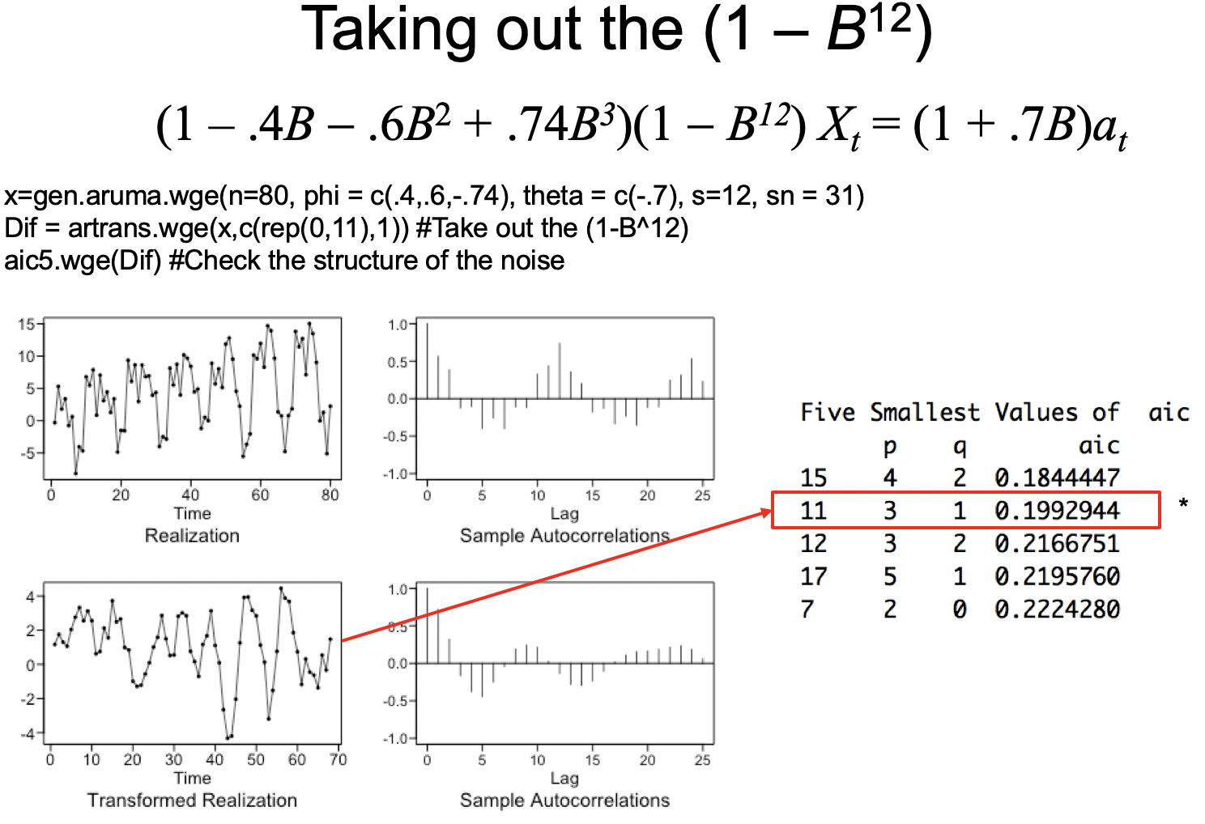
Key Takeaways
Seasonal Models | Generate And Stationarize

Slide 24
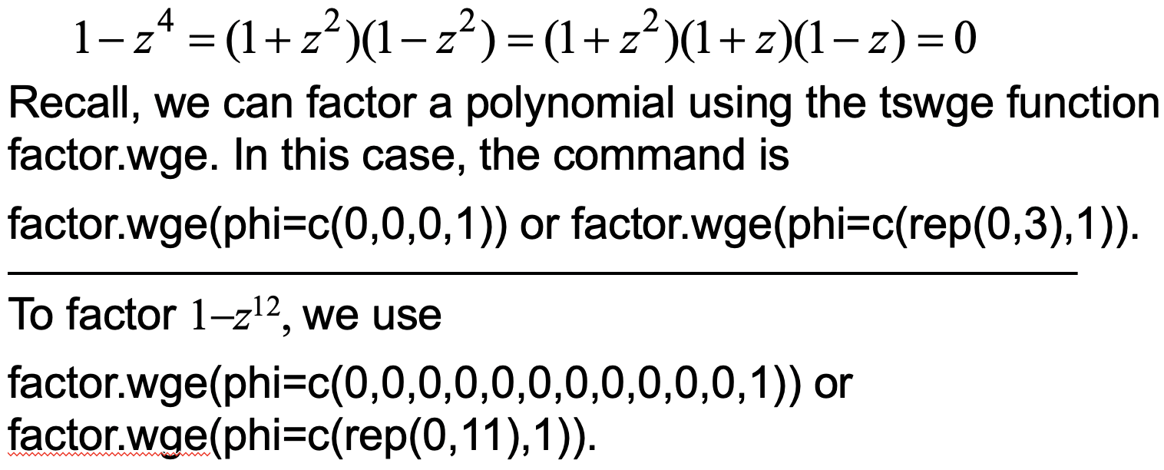
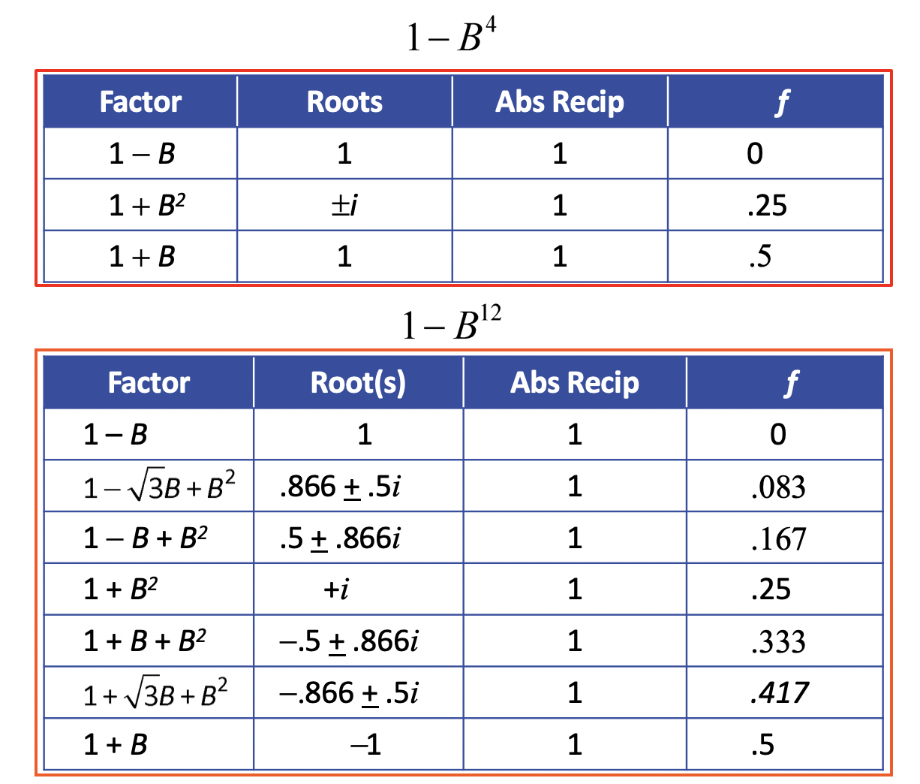
Key Takeaways
Seasonal Models | Factor Table

Slide 25
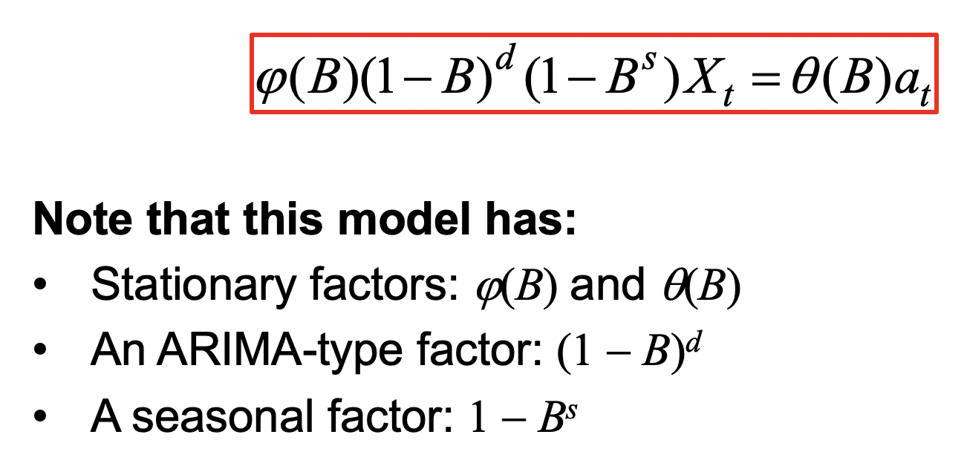
Key Takeaways
Seasonal Models | General Seasonal Model

Slide 26
Questions
How to fit signal plus noise models and isolate Zt process from them ?
How does autocorrelation structure of Signal plus noise models look like ? Does it only depend upon autocorrelation structure of Zt component ?

